Slide 1

Programming in C & C++
I.T Lab
[Rajasthan Institute of Engineering and technology]
Presentation on
< presented by – Raj Goswami>
20EREAD016
Department of Computer science and engineering

Slide 2
.
IMPORTANT SUB-TOPICS
.
Operators
Friend Class and Friend Function
Class and Object
Conditional Statements
Access Specifiers
Constructors and Destructors
Loops
Polymorphism
Inheritance
Arrays
User Defined Data Types

Slide 3
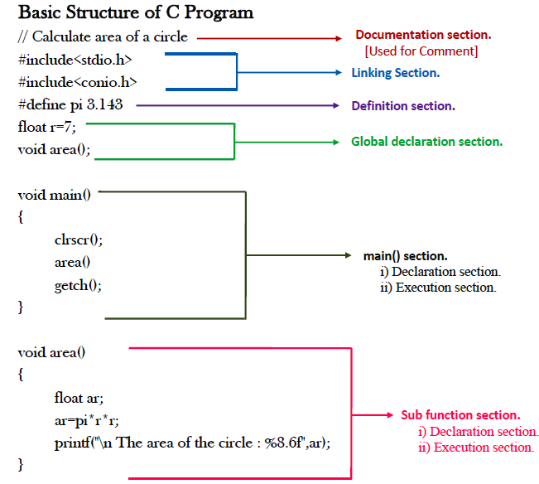
Basic Structure of a C program
.
C Programming Language

Slide 4
Operators in C programming
C Arithmetic Operators
Operator | Meaning of Operator
+ | addition or unary plus
- | subtraction or unary minus
* | multiplication
/ | division
% | remainder after division (modulo division)

Slide 5
Operators in C programming
C Assignment Operators
Operator | Example | Same as
= | a = b | a = b
+= | a += b | a = a+b
-= | a -= b | a = a-b
*= | a *= b | a = a*b
/= | a /= b | a = a/b
%= | a %= b | a = a%b

Slide 6
Operators in C programming
C Relational Operators
Operator | Meaning of Operator | Example
== | Equal to | 5 == 3 is evaluated to 0
> | Greater than | 5 > 3 is evaluated to 1
< | Less than | 5 < 3 is evaluated to 0
!= | Not equal to | 5 != 3 is evaluated to 1
>= | Greater than or equal to | 5 >= 3 is evaluated to 1
<= | Less than or equal to | 5 <= 3 is evaluated to 0

Slide 7
Operators in C programming
C Logical Operators
Operator | Meaning | Example
&& | Logical AND. True only if all operands are true | If c = 5 and d = 2 then, expression ((c==5) && (d>5)) equals to 0.
|| | Logical OR. True only if either one operand is true | If c = 5 and d = 2 then, expression ((c==5) || (d>5)) equals to 1.
! | Logical NOT. True only if the operand is 0 | If c = 5 then, expression !(c==5) equals to 0.

Slide 8
Operators in C programming
C Bitwise Operators
Operators | Meaning of operators
& | Bitwise AND
| | Bitwise OR
^ | Bitwise exclusive OR
~ | Bitwise complement
<< | Shift left
>> | Shift right
Increment and Decrement Operators
/* C programming has two operators increment ++ and decrement -- to change the value of an operand (constant or variable) by 1. */

Slide 9
Conditional Statements’ {
forbeginners.html
C programming
If statement
< The single if statement in C language is used to execute the code if a condition is true. It is also called one-way selection statement.>
Syntax
if(expression)
{ //code to be executed
}
How "if" statement works..
If the expression is evaluated to nonzero (true) then if block statement(s) are executed.
If the expression is evaluated to zero (false) then Control passes to the next statement following it.
}
Programming Language

Slide 10
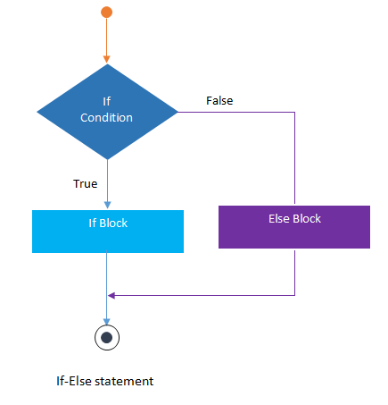
Conditional Statements’ {
C programming
If-else statement
< The if-else statement in C language is used to execute the code if condition is true or false. It is also called two-way selection statement..>
How "if..else" statement works..
If the expression is evaluated to nonzero (true) then if block statement(s) are executed.
If the expression is evaluated to zero (false) then else block statement(s) are executed.
if(expression)
{
//Statements
}
else
{
//Statements
}
}
Programming Language

Slide 11
Conditional Statements’ {
Nested If-else statement
< The nested if...else statement is used when a program requires more than one test expression. It is also called a multi-way selection statement. When a series of the decision are involved in a statement, we use if else statement in nested form. >
if( expression )
{
if( expression1 )
{
statement-block1;
}
else
{
statement-block 2;
}
}
else
{
statement-block 3;
}
}
Programming Language

Slide 12
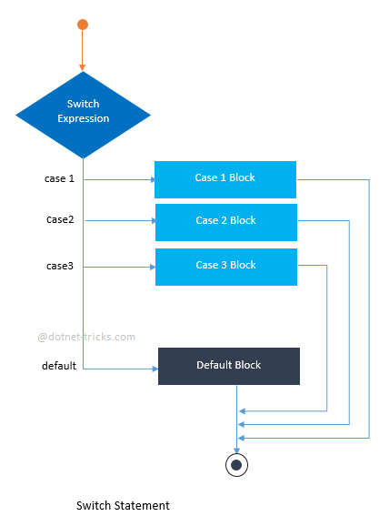
Conditional Statements’ {
Switch Statement
< switch statement acts as a substitute for a long if-else-if ladder that is used to test a list of cases. A switch statement contains one or more case labels which are tested against the switch expression. When the expression match to a case then the associated statements with that case would be executed..>
Switch (expression)
{
case value1:
//Statements
break;
case value 2:
//Statements
break;
case value 3:
//Statements
case value n:
//Statements
break;
Default:
//Statements
}
}

Slide 13
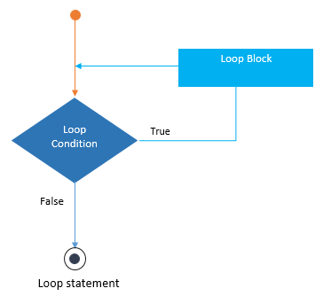
01 { While Loop
[This loop executes a statement or a block of statements until the specified Boolean expression evaluates to false.]
Loops
< Typically, while loop is useful when you are not aware of exact number of iterations.>
}
Programming Language

Slide 14
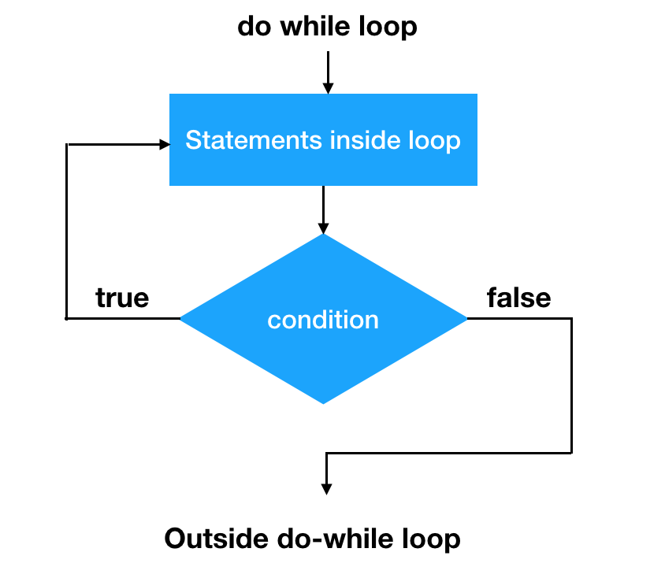
02 { Do-While-Loop
[This loop executes a statement or a block of statements until the specified Boolean expression evaluates to false..]
Loops
}
Programming Language

Slide 15
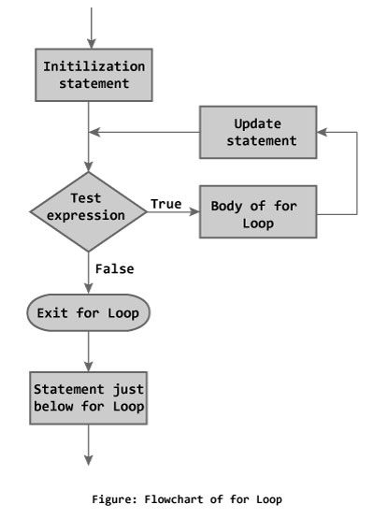
03 { For Loop
[This loop has three sections - index declaration, condition (Boolean expression) and updating section. In each for loop iteration, the index is updated (incremented/decremented) by updating section and checked with the condition. If the condition is matched, it continues execution until the specified Boolean expression evaluates to false..]
Loops
}
Programming Language

Slide 16
Array
<An array in C/C++ or be it in any programming language is a collection of similar data items stored at contiguous memory locations and elements can be accessed randomly using indices of an array. They can be used to store collection of primitive data types such as int, float, double, char, etc. of any particular type.>
Array elements are accessed by using an integer index. Array index starts with 0 and goes till size of array minus 1.
0
1
2
3
4
5
Sardine
Carp
Squid
Dentex
Zander
Shark

Slide 17
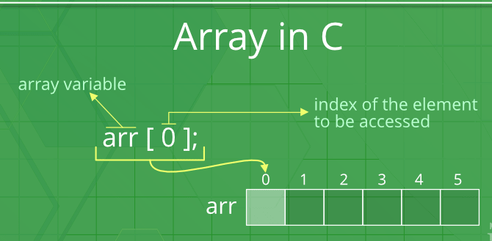
Array
Advantages of an Array in C/C++:
Random access of elements using array index.
Use of less line of code as it creates a single array of multiple elements.
Easy access to all the elements.
Traversal through the array becomes easy using a single loop.
Sorting becomes easy as it can be accomplished by writing less line of code.
0
1
2
3
4
5
Sardine
Carp
Squid
Dentex
Zander
Shark
For example – an array of fishes ( total fishes = 6 , indexing from 0 to 5 )

Slide 18
Class <1> {
C++ programming
Concept of class & Objects
< A class in C++ is the building block that leads to Object-Oriented programming. It is a user-defined data type, which holds its own data members and member functions, which can be accessed and used by creating an instance of that class. A C++ class is like a blueprint for an object.>
}
objects <2> {
An Object is an instance of a Class. When a class is defined, no memory is allocated but when it is instantiated (i.e. an object is created) memory is allocated.>
Declaring Objects: When a class is defined, only the specification for the object is defined; no memory or storage is allocated. To use the data and access functions defined in the class, you need to create objects.
}
Programming Language
ClassName ObjectName;

Slide 19
Accessing data members and member functions:{
C++ programming
Concept of class & Objects
< The data members and member functions of class can be accessed using the dot(‘.’) operator with the object. For example if the name of object is obj and you want to access the member function with the name printName() then you will have to write obj.printName() .>
}
There are three access modifiers : public, private and protected.
The public data members are also accessed in the same way given however the private data members are not allowed to be accessed directly by the object. Accessing a data member depends solely on the access control of that data member.
}
Programming Language
ClassName ObjectName;

Slide 20
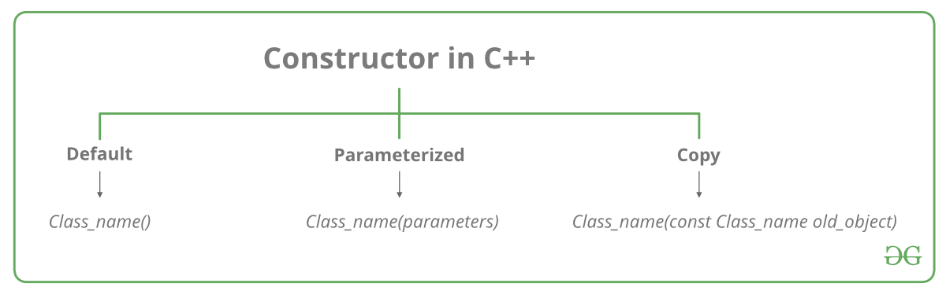
Constructors <1> {
C++ programming
Concept of class & Objects
< A constructor is a member function of a class that has the same name as the class name. It helps to initialize the object of a class. It can either accept the arguments or not. It is used to allocate the memory to an object of the class. It is called whenever an instance of the class is created. It can be defined manually with arguments or without arguments. .>
ClassName()
{ //Constructor's Body }
Constructors are of three types:
Default Constructor.
Parametrized Constructor.
Copy Constructor.
}
Programming Language
ClassName ObjectName;

Slide 21
C++ programming
Concept of class & Objects
Destructors
What is a destructor?
Destructor is an instance member function which is invoked automatically whenever an object is going to be destroyed. Meaning, a destructor is the last function that is going to be called before an object is destroyed.
Destructor function is automatically invoked when the objects are destroyed.
It cannot be declared static or const.
The destructor does not have arguments.
It has no return type not even void.
C ++ Programming Language
~constructor-name();

Slide 22
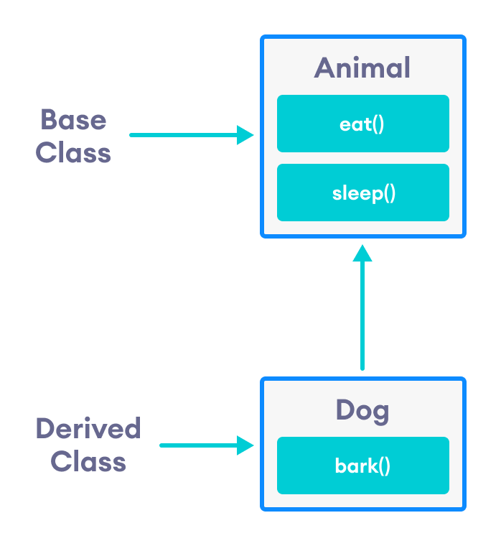
What Is this ‘Inheritance?’ in C++ {
C++ programming
inheritance
The capability of a class to derive properties and characteristics from another class is called Inheritance. Inheritance is one of the most important feature of
Object Oriented Programming.
< Super/Parent Class: The class whose properties are inherited by sub class is called Base Class or Super class.>
60%
< Sub/Child Class: The class that inherits properties from another class is called Sub class or Derived Class. >
}
Programming Language
class derived-class: visibility-mode base-class

Slide 23
{ Types of Inheritance:
C++ programming
inheritance
<1> Single Inheritance In single inheritance, there is only one base class and one derived class. The Derived class gets inherited from its base class. This is the simplest form of inheritance.
<2>Multiple Inheritance
In this type of inheritance, a single derived class may inherit from two or more base classes.
<3> Hierarchical Inheritance
In this type of inheritance, multiple derived classes get inherited from a single base class.
<4>Multilevel Inheritance
The classes can also be derived from the classes that are already derived.
<5> Hybrid Inheritance
This is a Mixture of two or More Inheritance and in this Inheritance, a Code May Contains two or Three types of inheritance in Single Code
}
Programming Language
40%

Slide 24
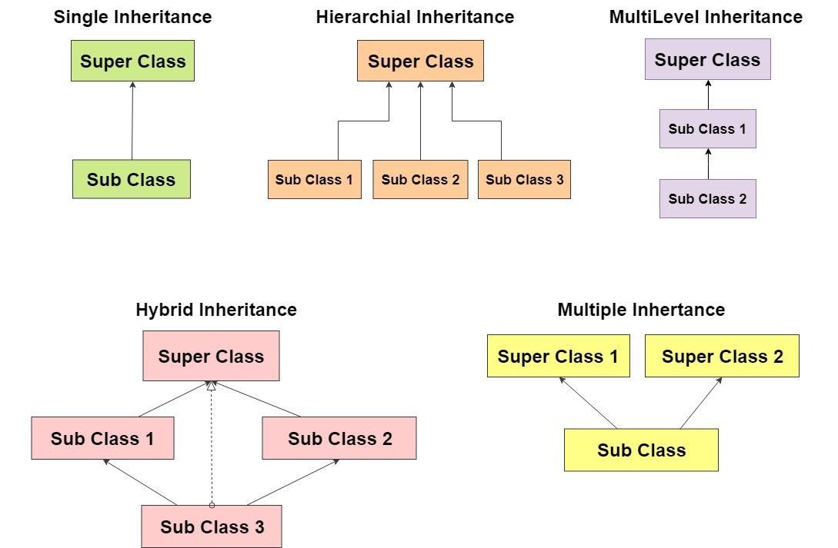
{ Types of Inheritance:
}
40%

Slide 25
Friend class
Friend function
A friend class can access private and protected members of other class in which it is declared as friend. It is sometimes useful to allow a particular class to access private members of other class. For example, a LinkedList class may be allowed to access private members of Node.
01
02
class Node {
private:
int key;
Node* next;
/* Other members of Node Class */
// Now class LinkedList can
// access private members of Node
friend class LinkedList;
};
03
04
}
C++ Programming Language

Slide 26
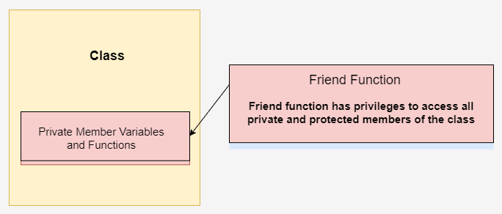
Friend function; {
Friend class and friend function
Friend Function Like friend class, a friend function can be given a special grant to access private and protected members. A friend function can be: a) A member of another class b) A global function
}
class className{ // Other Declarations friend returnType functionName(arg list); };
C++ Programming Language

Slide 27
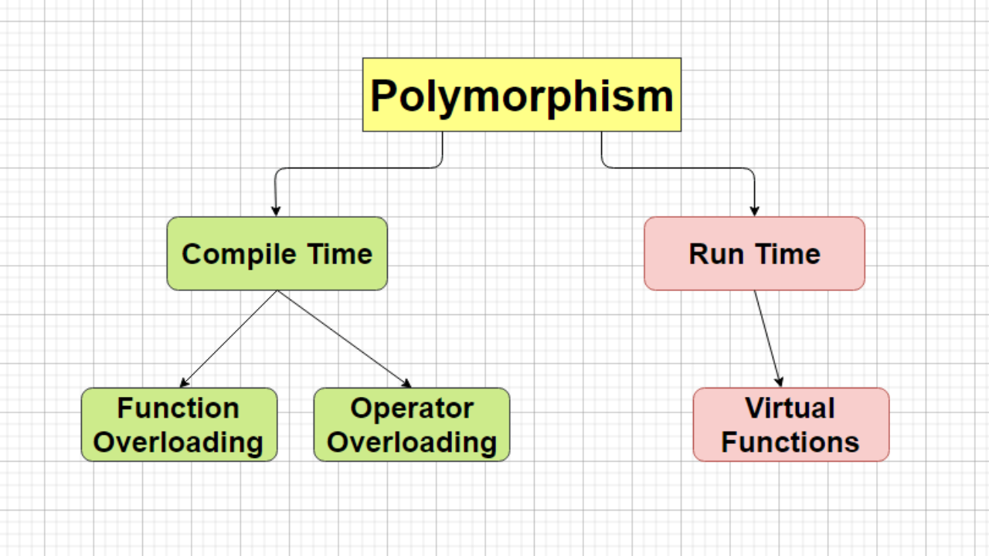
‘Polymorphism’ .
Polymorphism in C++ means, the same entity (function or object) behaves differently in different scenarios
In simple words, we can define polymorphism as the ability of a message to be displayed in more than one form.
Polymorphism is considered as one of the important features of Object Oriented Programming.

Slide 28
Functional Overloading{
overloading
< Function overloading is a feature of object oriented programming where two or more functions can have the same name but different parameters. When a function name is overloaded with different jobs it is called Function Overloading >
#include <iostream>
using namespace std;
void addnum(int,int);
void addnum(int,int,int);
int main() {
addnum (5,5);
addnum (5,2,8);
return 0; }
void addnum (int x, int y)
{ cout<<"Integer number: "<<x+y<<endl; }
void addnum (int x, int y, int z)
{ cout<<"Float number: "<<x+y+z<<endl; }
}

Slide 29

Operator Overloading{
< Operator overloading means adding extra functionality for a certain operator. When an operator is overloaded, the operator has different meanings, which depend on the type of its operands. >

Slide 30
Function Over-riding
Virtual function
<when a derived class has a definition for one of the member functions of the base class. That base function is said to be overridden.>
Virtual functions ensure that the correct function is called for an object, regardless of the type of reference (or pointer) used for function call.
They are mainly used to achieve Runtime- Polymorphism
Functions are declared with a virtual keyword in base class.
The resolving of function call is done at Run-time.
A virtual function is a member function which is declared within a base class and is re-defined(Overridden) by a derived class. When you refer to a derived class object using a pointer or a reference to the base class, you can call a virtual function for that object and execute the derived class’s version of the function.

Slide 31
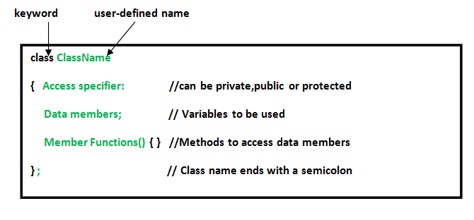
User-defined datatypes {
<1> Class
The building block of C++ that leads to Object-Oriented programming is a Class. It is a user-defined data type, which holds its own data members and member functions, which can be accessed and used by creating an instance of that class. A class is like a blueprint for an object.
}
Programming Language

Slide 32
User-defined datatypes {
<2> Structure
A structure is a user defined data type in C/C++. A structure creates a data type that can be used to group items of possibly different types into a single type.
struct address
{
char name[50];
char street[100];
char city[50];
char state[20];
int pin;
};
}
Programming Language

Slide 33
User-defined datatypes {
<3> Union
union is a user defined data type. In union, all members share the same memory location. For example in the following C program, both x and y share the same location. If we change x, we can see the changes being reflected in y.
<4> Enumeration
Enumeration (or enum) is a user defined data type in C. It is mainly used to assign names to integral constants, the names make a program easy to read and maintain.
}
enum State {Working = 1, Failed = 0};
Programming Language

Slide 34
Thank you for your patience
Programming Language

Slide 35
— Someone ‘Famous’
forbeginners.html
workshop.css
< “This is a quote, words full of wisdom that someone important said and can make the reader get inspired.” >
Programming Language

Slide 36
THE END

